Slide 1

ZOMATO RESTAURANT ANALYSIS

Slide 2
INDEX
ABOUT ZOMATO ANALYSIS
OBJECTIVES AND WORKFLOW
KPI’s AND OBSERVATION
MS EXCEL MODULE
MY SQL MODULE
TABLEAU MODULE
POWER BI MODULE
CHALLENGES & LEARNING
CONCLUSION & FUTURE IMPROVEMENTS

Slide 3
ABOUT ZOMATO DATASET
DATASET:- Zomato Restaurants Dataset
INDUSTRY:- Food & Restaurants / Online Food Service
DATASET FOCUS:- Restaurant-level information covering restaurants across different countries & cities, along with ratings, pricing, cuisines, table booking status & online delivery information.

Slide 4
OBJECTIVE & WORKFLOW
Perform Geographical analysis of restaurants.
Analyze restaurant rating distribution.
Understand price analysis.
Analyze restaurant’s opening trend.
Built meaningful KPI’s.
Create interactive dashboards.
SQL
(Data importing, Joins, ROLLUP)
Microsoft Excel
(Cleaning, Bucketing, Pivot table)
Raw Data
Tableau
(Charts, Filter, Dashboard )
Power BI
(Data importing, data model, DAX)

Slide 5
KPI’S & OBSERVATIONS
KPI’S
OBSERVATION
  India accounts for highest number of restaurants.
  Among all cities New Delhi has highest restaurants count.
  The 3.0 – 3.5 rating range contains largest number of restaurants.(2490)
  Most restaurants fall within ₹251- ₹500 average cost range.(3469)
  25.66% of restaurants provide online delivery compared to 12.12% offering table booking.
  The highest number of restaurants opened in 2018.
TOTAL RESTAURANTS
9551
TOTAL COUNTRIES
15
TOTAL CITIES
141
AVERAGE RATING
2.89
AVERAGE COST FOR TWO
₹1199

Slide 6
MS EXCEL MODULE
Key Activities :-
Data cleaning & preparation
Created rating buckets
Created price buckets
Created Pivot tables
Created Charts
Dashboard
OUTCOME:-
Prepared, cleaned and analyzed the Zomato dataset using Excel, created meaningful categories and visualizations, and developed an interactive dashboard to present key restaurant insights clearly.

Slide 7
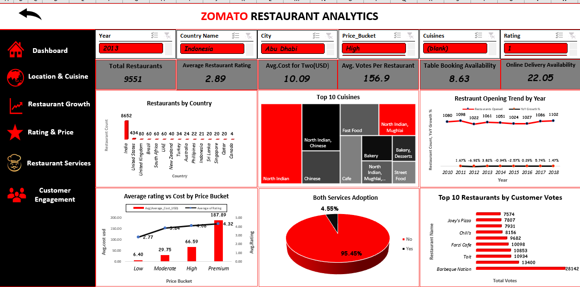

Slide 8
MYSQL MODULE
Key Activities:-
Imported CSV using LOAD DATA LOCAL INFILE
Created country map table
Created calendar table
Modified Datekey
Used JOINS
Used ROLLUP
Used GROUP BY
OUTCOME:-
Successfully transformed and analyzed the Zomato dataset using MySQL, creating supporting tables, applying SQL queries, joins, date functions, ROLLUP and aggregations to generate meaningful restaurant insights and validate the analysis.

Slide 9
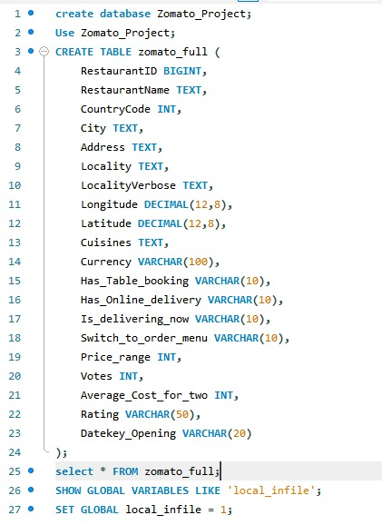
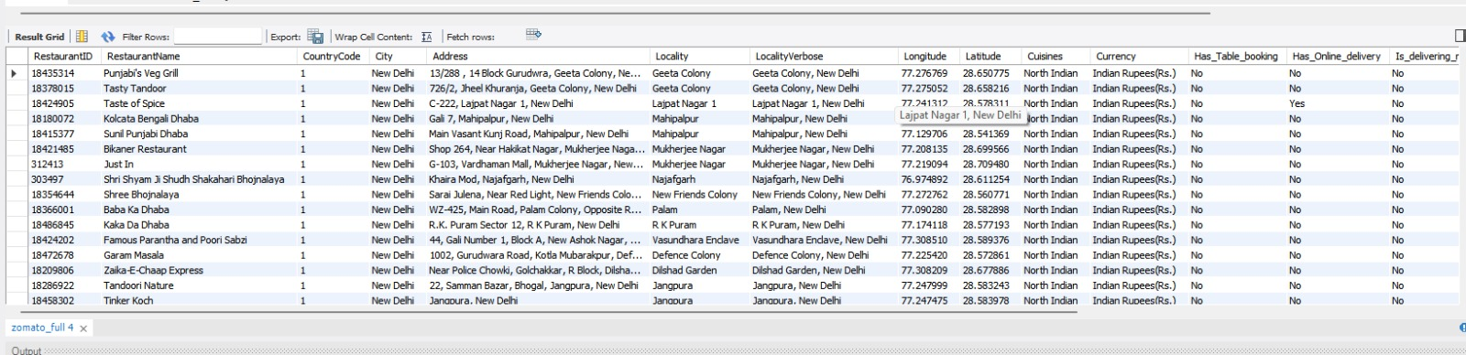
MYSQL QUERIES & OUTPUT
Zomato table

Slide 10
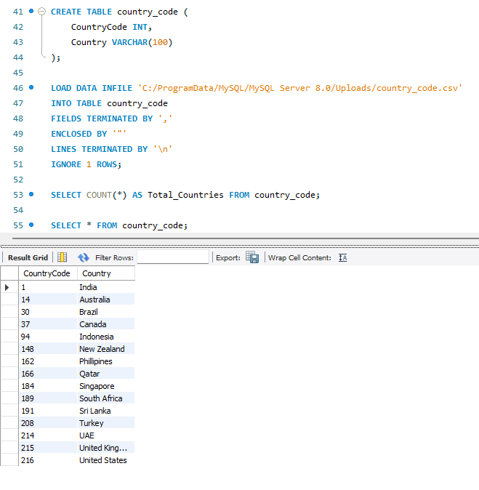
MYSQL QUERIES & OUTPUTS
Country code table

Slide 11
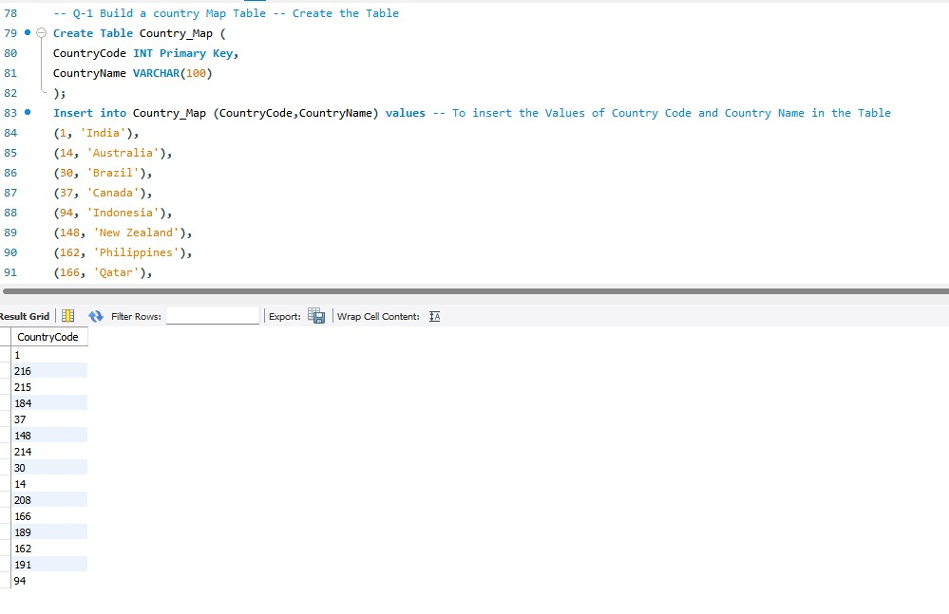
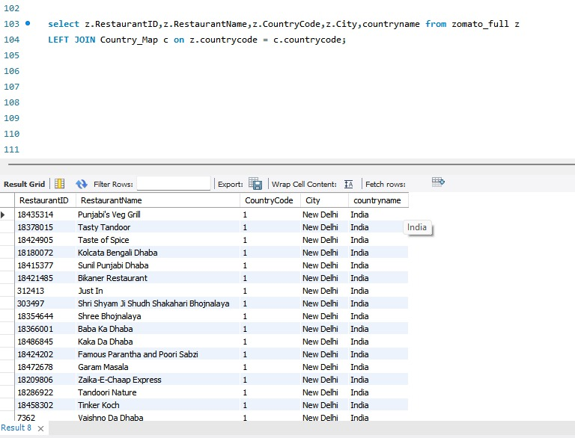
MYSQL QUERIES & OUTPUTS
Q1

Slide 12
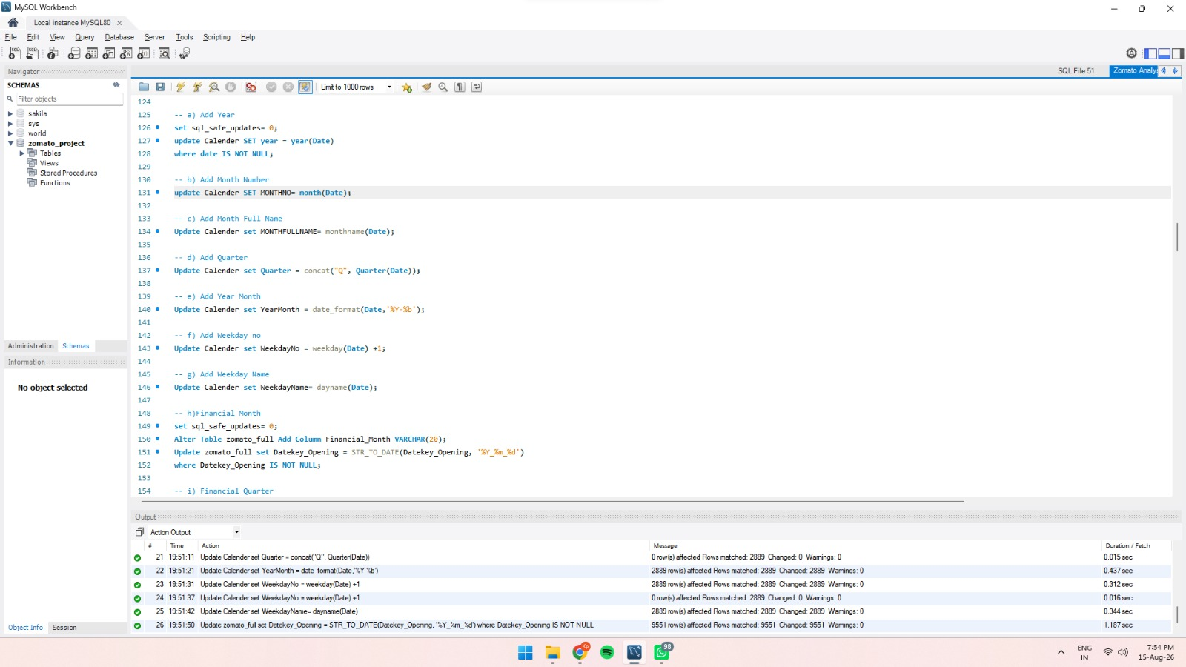
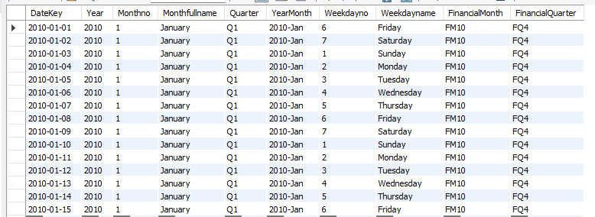
MYSQL QUERIES & OUTPUTS
Q2

Slide 13
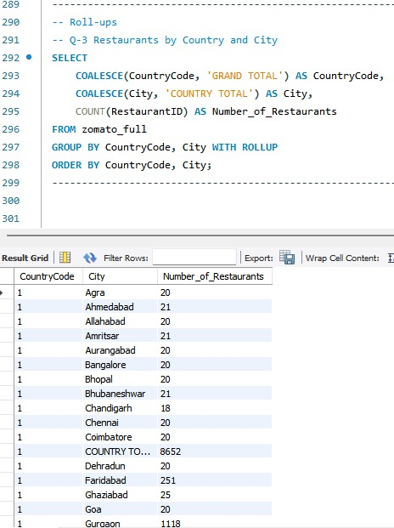
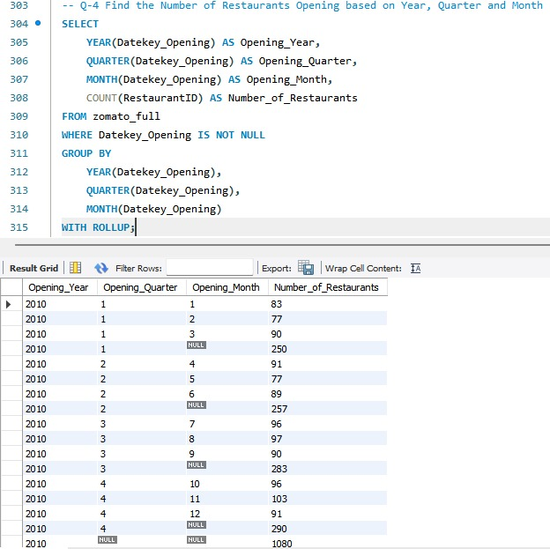
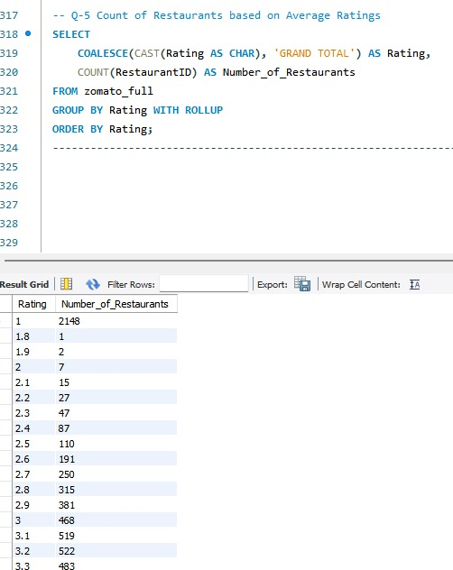
Q3 Q4 Q5
MYSQL QUERIES & OUTPUTS

Slide 14
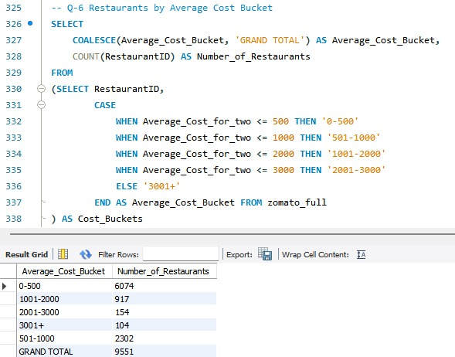
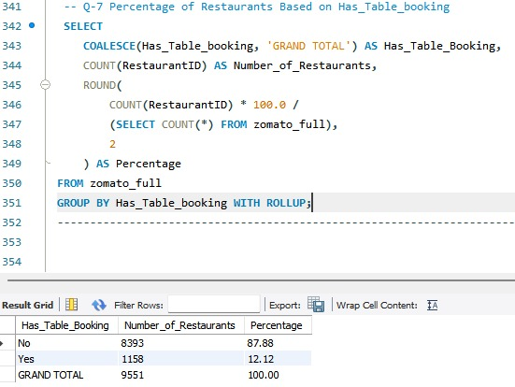
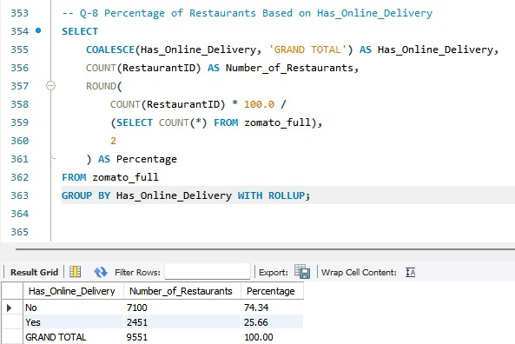
MYSQL QUERIES & OUTPUTS
Q6 Q7 Q8

Slide 15
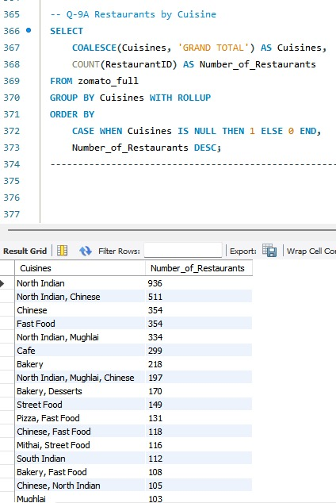
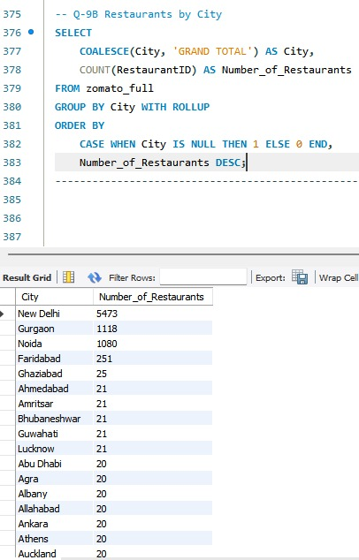
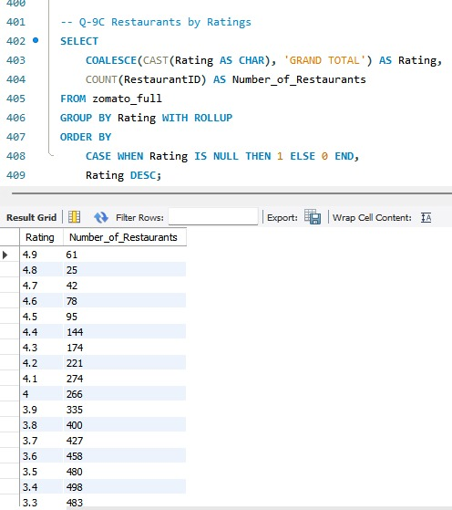
MYSQL QUERIES & OUTPUTS
Q9(a) Q9(b) Q9(c)

Slide 16
TABLEAU MODULE
Key Activities
Connected data to Tableau
Analyze restaurants opening trend
Used filters
Created interactive visualization
Dashboard
OUTCOME:-
Developed an interactive Tableau dashboard to visualize restaurant distribution, ratings, pricing, cuisines, services and restaurant opening trends, making the Zomato analysis easier to explore and understand.

Slide 17
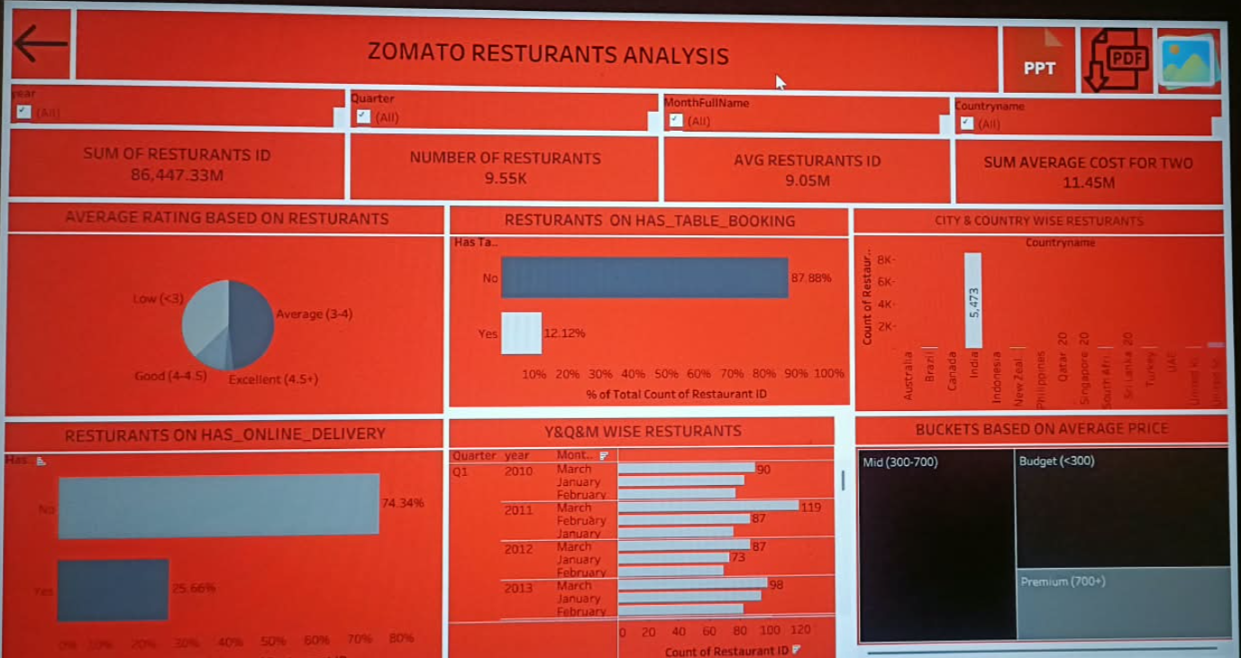

Slide 18
MS POWER BI MODULE
Key Activities:-
Installed MySQL connector
Connected MySQL database to Power BI
Imported tables
Created Data relationship
Created KPI’s
Added Slicers
Created Dashboard
OUTCOME:-
Connected and modeled the Zomato data in Power BI, created relationships, calculated fields, KPIs, slicers and interactive visualizations, and developed a dynamic dashboard to present key restaurant insights clearly.

Slide 19
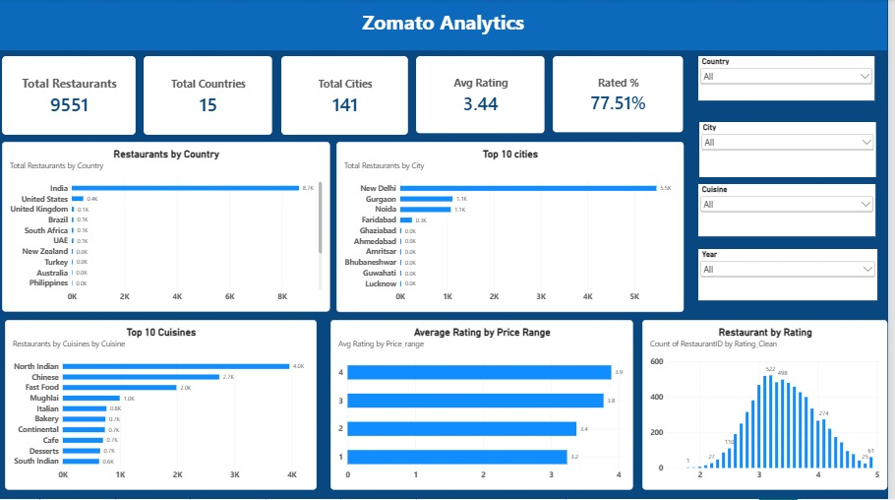

Slide 20
CHALLENGES & LEARNING
CHALLENGES
HOW WE OVERCAME
Creating rating and price buckets.
Importing the Zomato CSV into MySQL.
Connecting MySQL to Power BI.
Created calculated bucket categories to make restaurant ratings and prices easier to analyze.
Used the LOAD DATA LOCAL INFILE method to import CSV into My SQL & successfully load the datasets.
Installed the required MySQL connector, established the connection between My SQL & Power BI, and imported the required tables for analysis.

Slide 21
CONCLUSION & FUTURE IMPROVEMENTS
CONCLUSION
FUTURE IMPROVEMENTS
Completed an end-to-end Zomato Restaurant Analysis project.
Used Excel, MySQL, Tableau & Power BI for analysis and visualization.
Identified key insights on restaurants, ratings, pricing, locations and services.
Developed interactive dashboards for better data understanding.
Use updated Zomato data for current trends.
Perform deeper cuisine and city analysis.
Add predictive analysis for future trends.
Use advanced Power BI & DAX features.
Analyze relationships between ratings, pricing and services.

Slide 22
THANK YOU !

